Slide 1
Basic Presentation about my hometown

Slide 2
Naogaon City
Country | Bangladesh
Division | Rajshahi Division
Headquarters | Naogaon
Government
• Deputy Commissioner | Md Golam Maola
Area
• Total | 3,435.67 km² (1,326.52 sq mi)
Population (2022)
• Total | 2,784,599
• Density | 810/km² (2,100/sq mi)

Slide 3
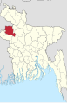
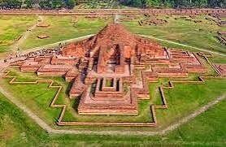
Most historical place called paharpur
This Photo by Unknown Author is licensed under CC BY-SA

Slide 4
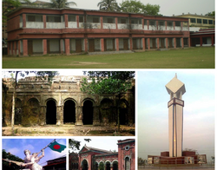
Some historical places
Naogaon City
This Photo by Unknown Author is licensed under CC BY-SA

Slide 5
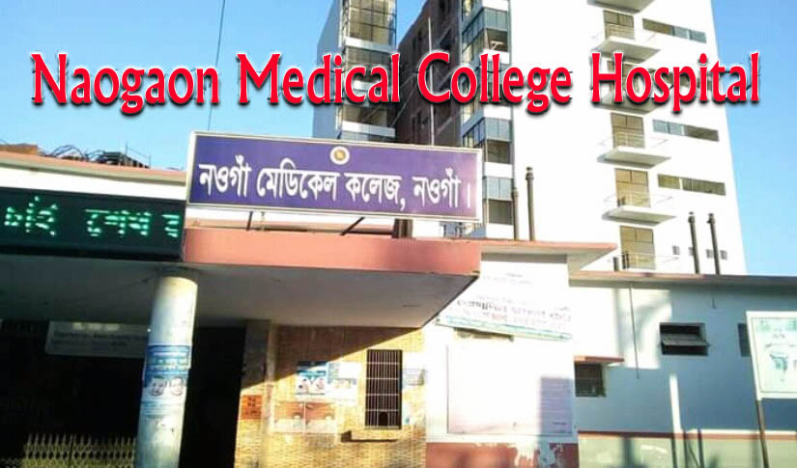
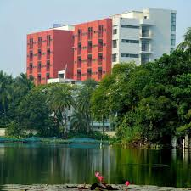
Naogaon Medical College
Naogaon Medical College is a government medical school in Naogaon, Bangladesh, founded in 2018 and affiliated with Rajshahi Medical University. The class of the first batch of 50 students was commenced on January 10, 2019, on its temporary campus of Naogaon Sadar Hospital (250 Bedded General Hospital, Naogaon)

Slide 6
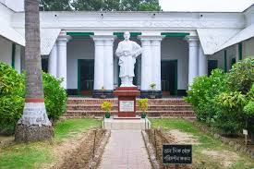
A full-body statue of Rabindranath Tagore in his middle age, by sculptor Kanak Kumar Pathak, at Patisar Kachari Bari premises, Atrai, Naogaon.

Slide 7
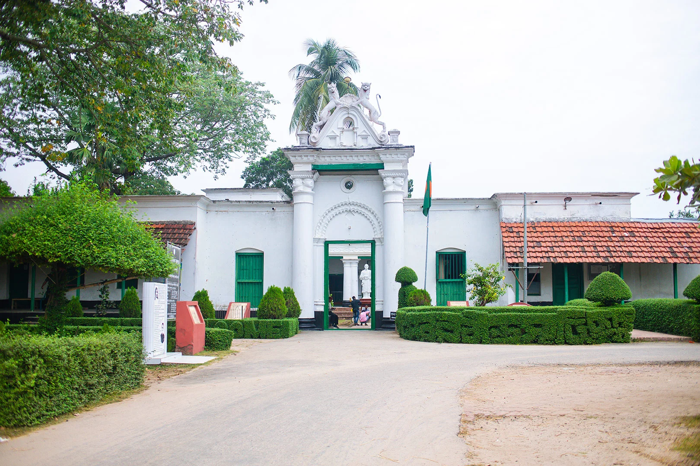
The Patisar Rabindra Kachari Bari in Atrai Upazila of Naogaon district served as the official headquarters for Rabindranath Tagore’s Kaligram zamindari estate. Here, Tagore’s officials would collect taxes, manage land records, and oversee various administrative tasks

Slide 8
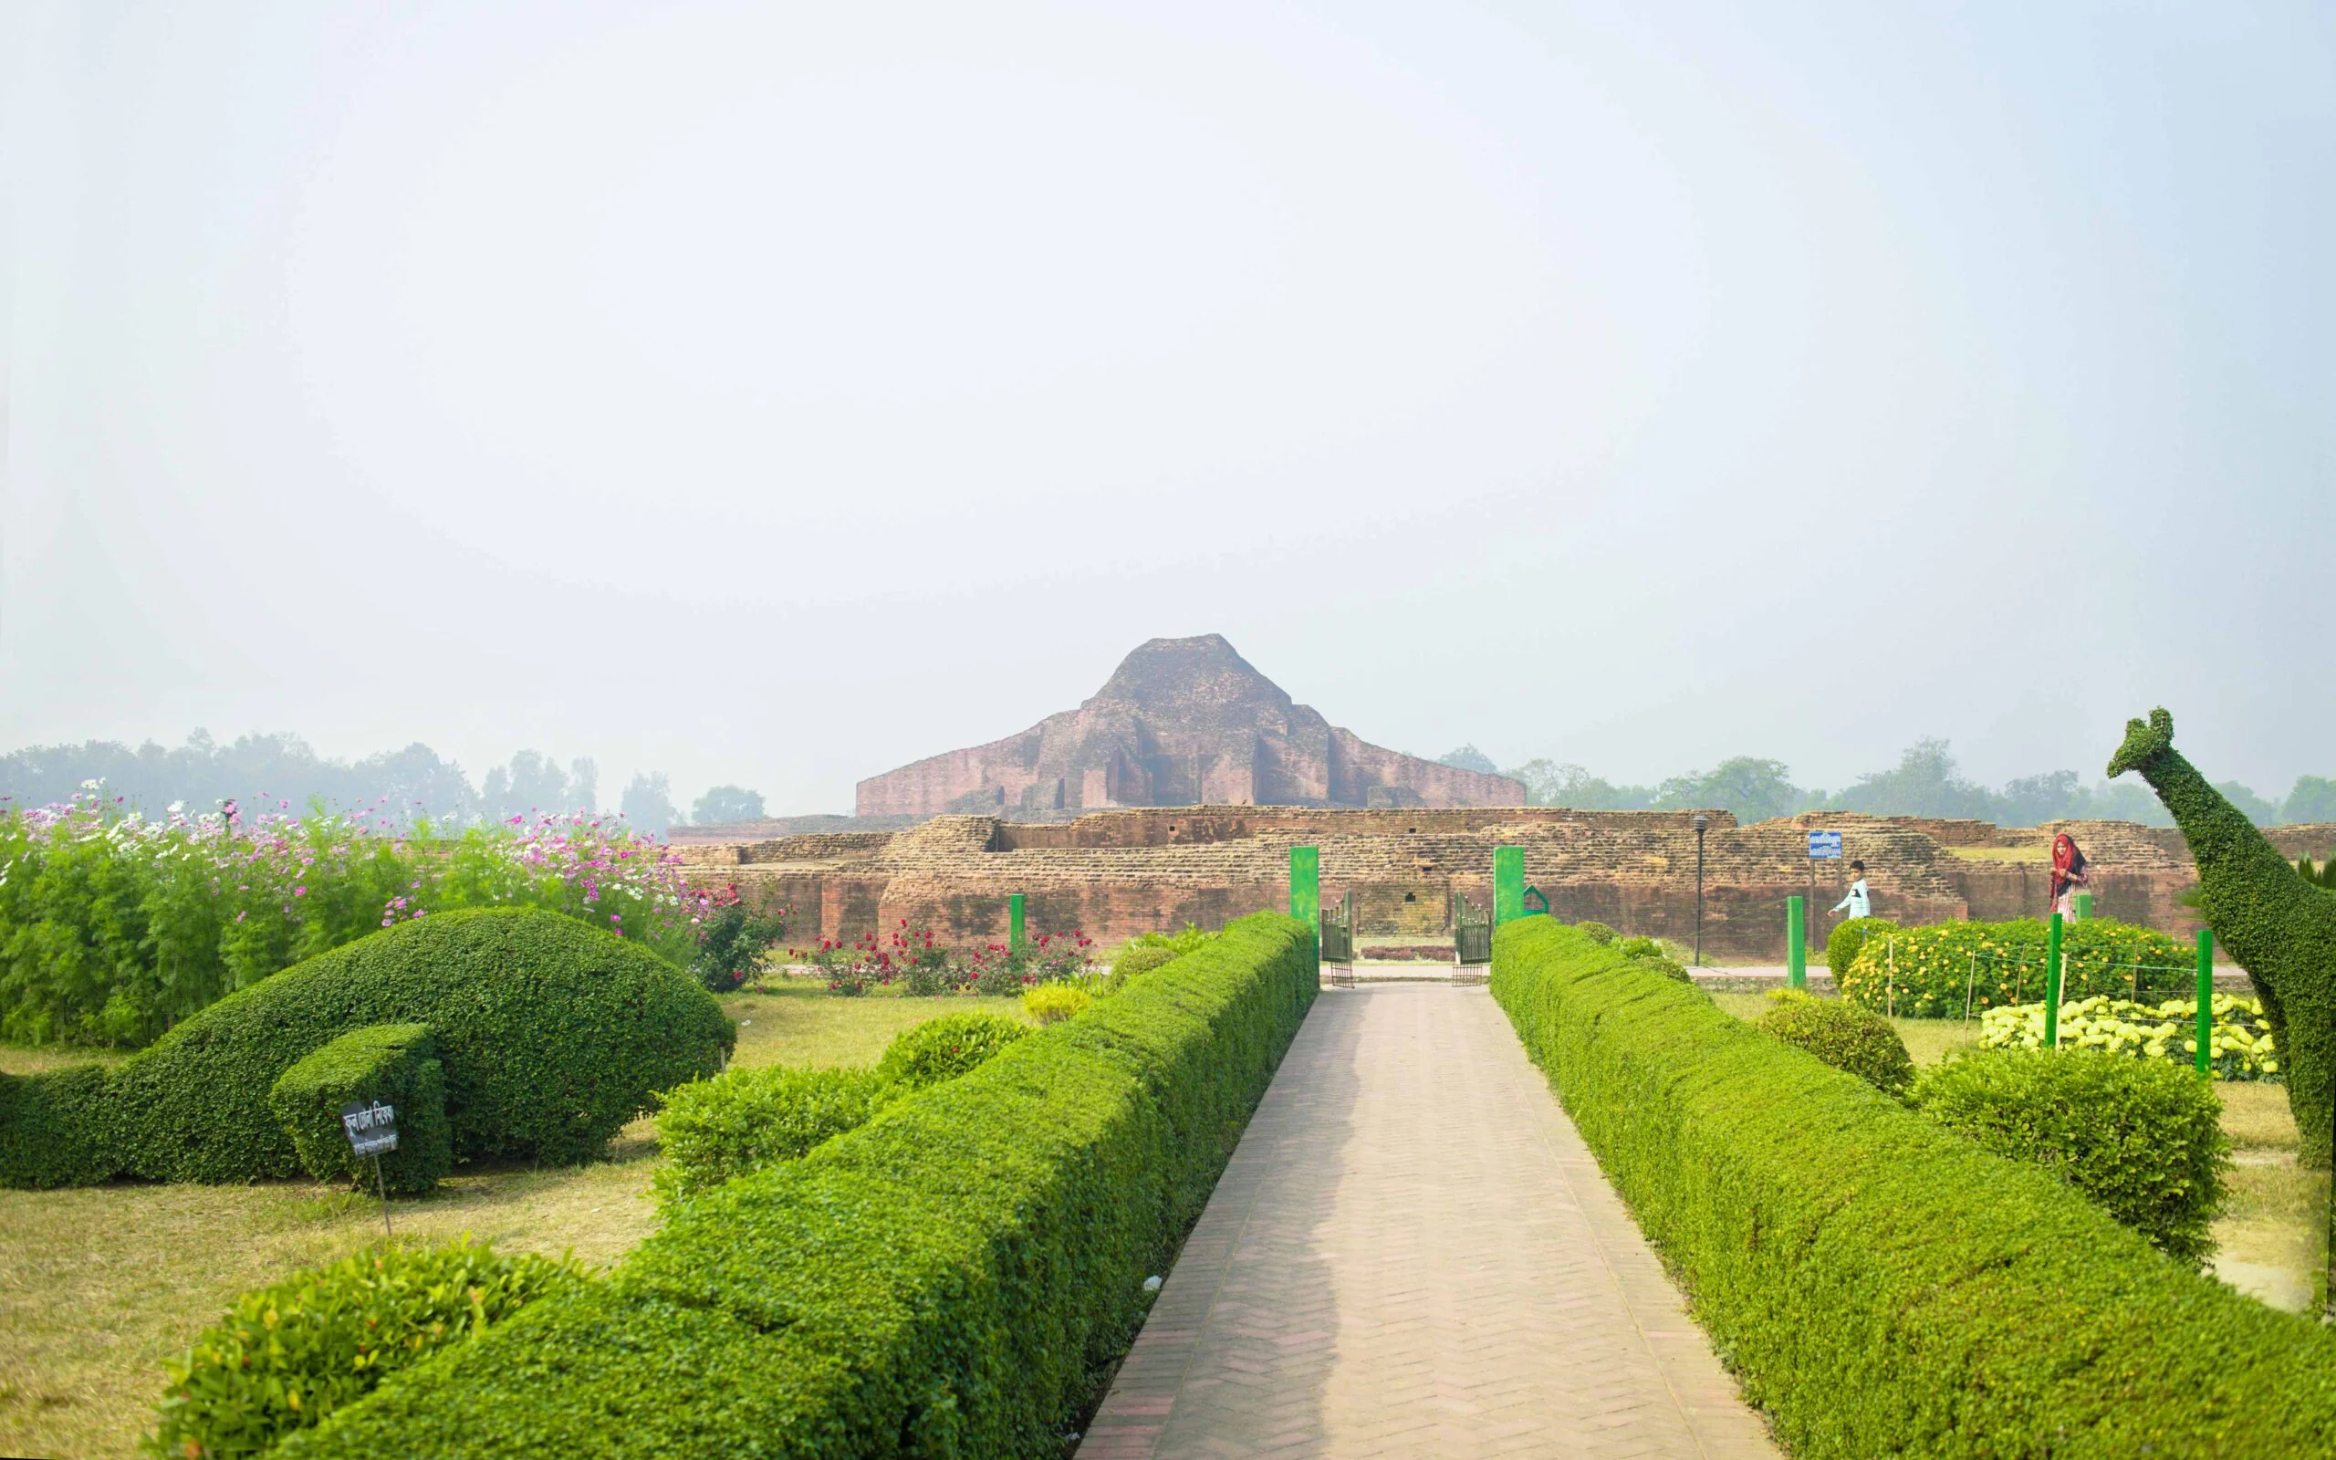
The central temple of Somapura Mahavihara, Naogaon district's renowned archaeological monument, also known to locals as Paharpur Bihar. It's a UNESCO World Heritage site.

Slide 9
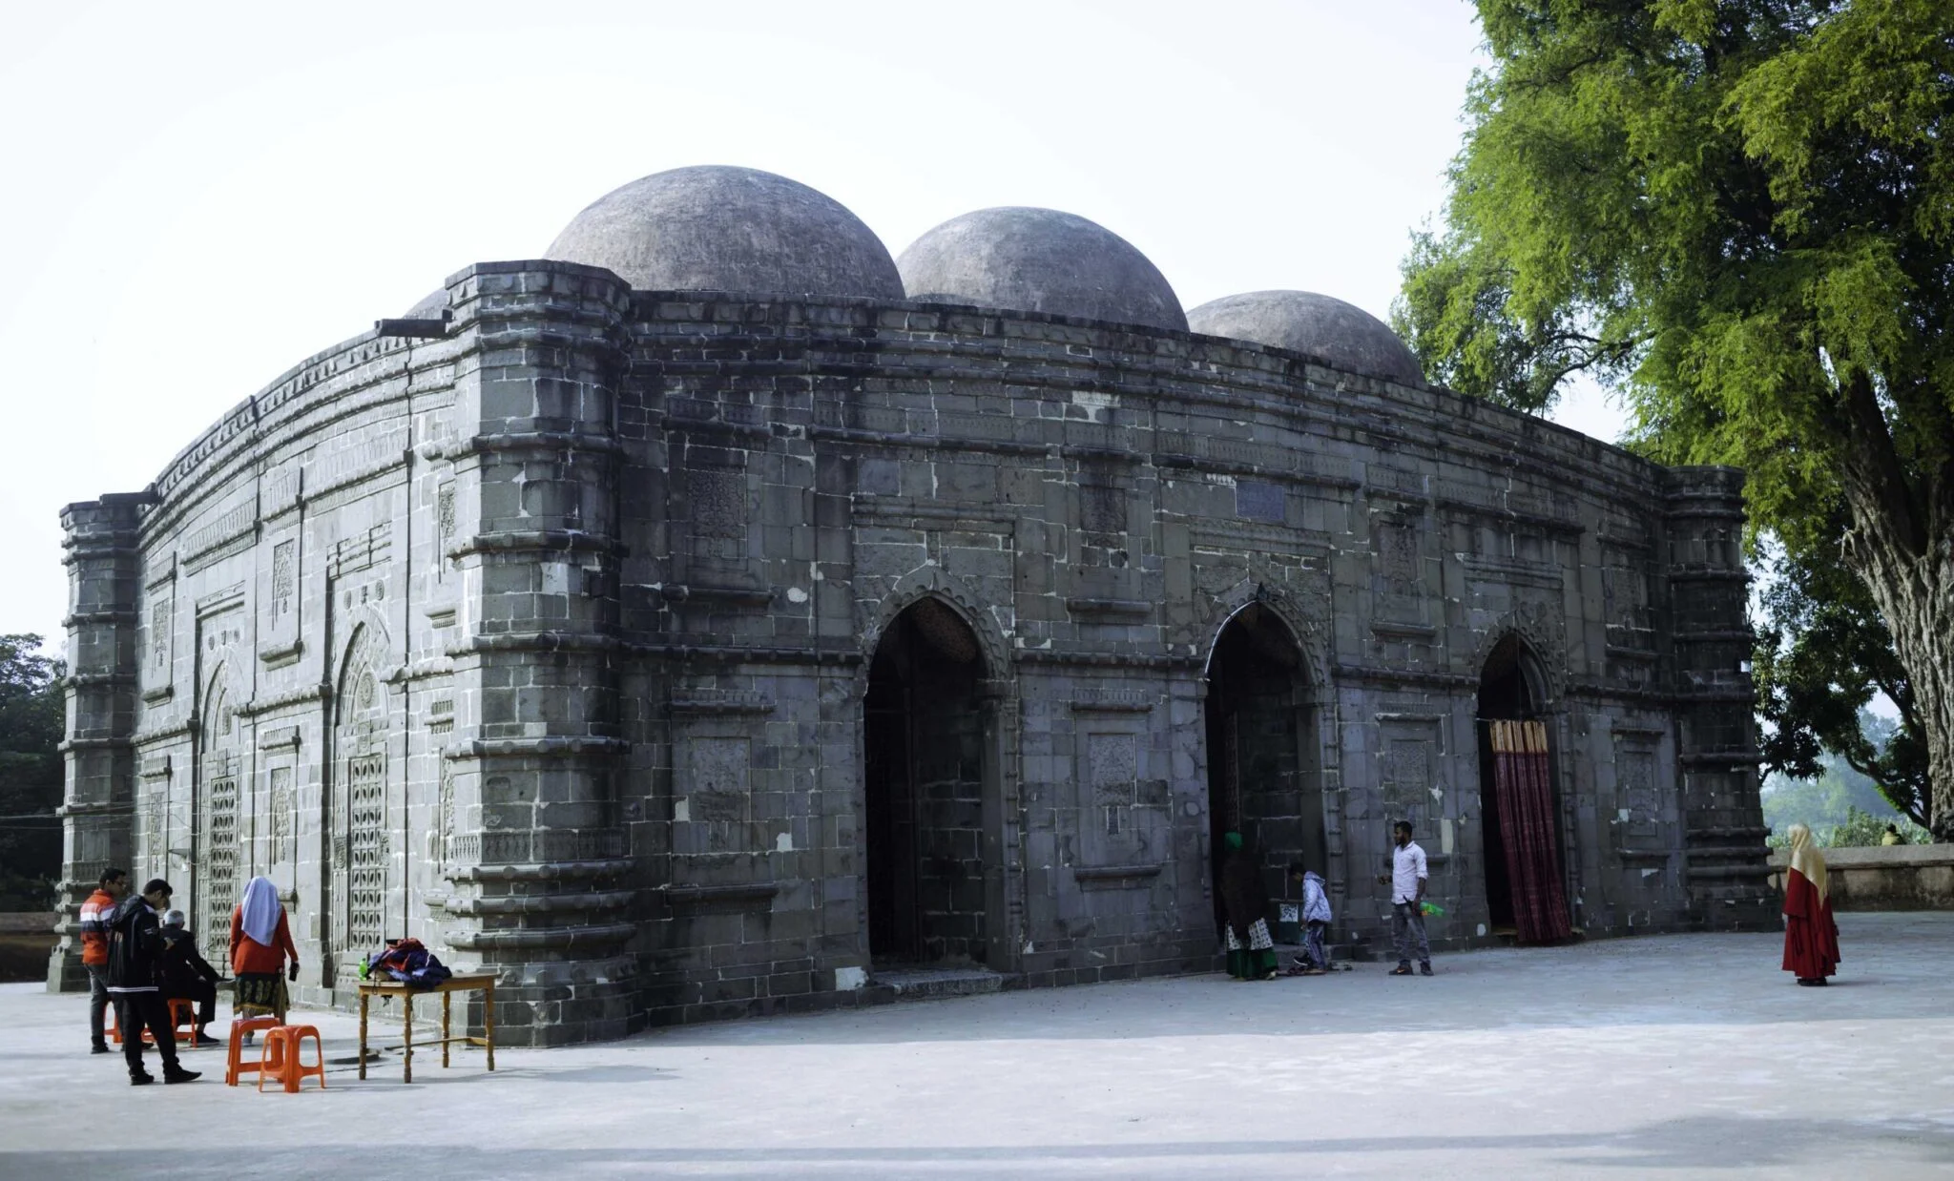
Kusumba Mosque, the second most important historical site in Naogaon district.

Slide 10
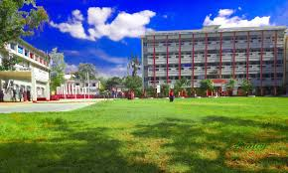
Naogaon Govt. College

Slide 11
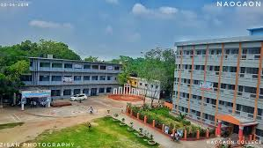
Naogaon Govt. College
Naogaon Government College (Bengali: নওগাঁ সরকারি কলেজ) is a public educational institution based in Naogaon District, Bangladesh. It was established in 1962^{[2]} with 300 students, and currently serves about 16,000. It is situated at the north-east part of Naogaon and is authorized by the National University.
Its 11-acre (45,000 m²) campus has two three-story buildings, one of which is used for administrative and academic purpose that also includes a library enriched with more than 25,000 books and another building is for science faculty.
Naogaon Government College was nationalized in 1980.

